Slide 1
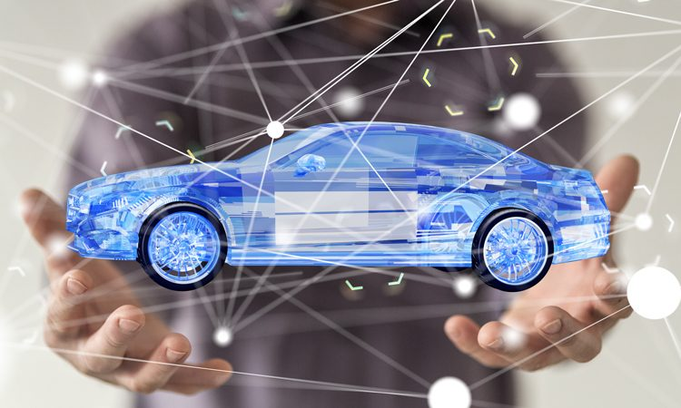
A Review on Blockchain Technologies for
Cyber-Resilient Automotives
Presenters Prerana Cheguru Sharani Regonda Vaishnavi Rao Delicia Fernandes

Slide 2
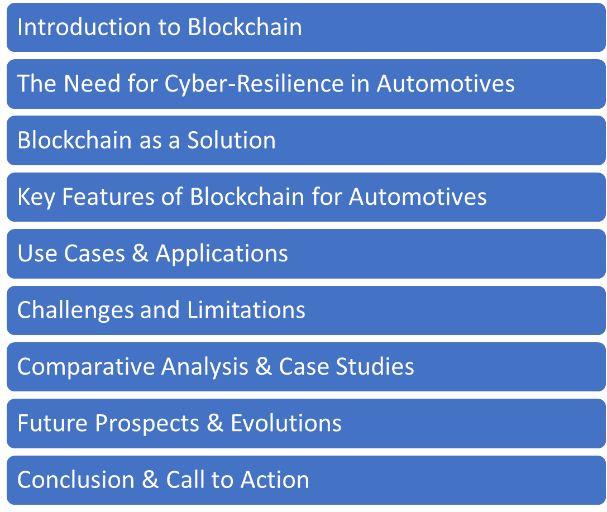
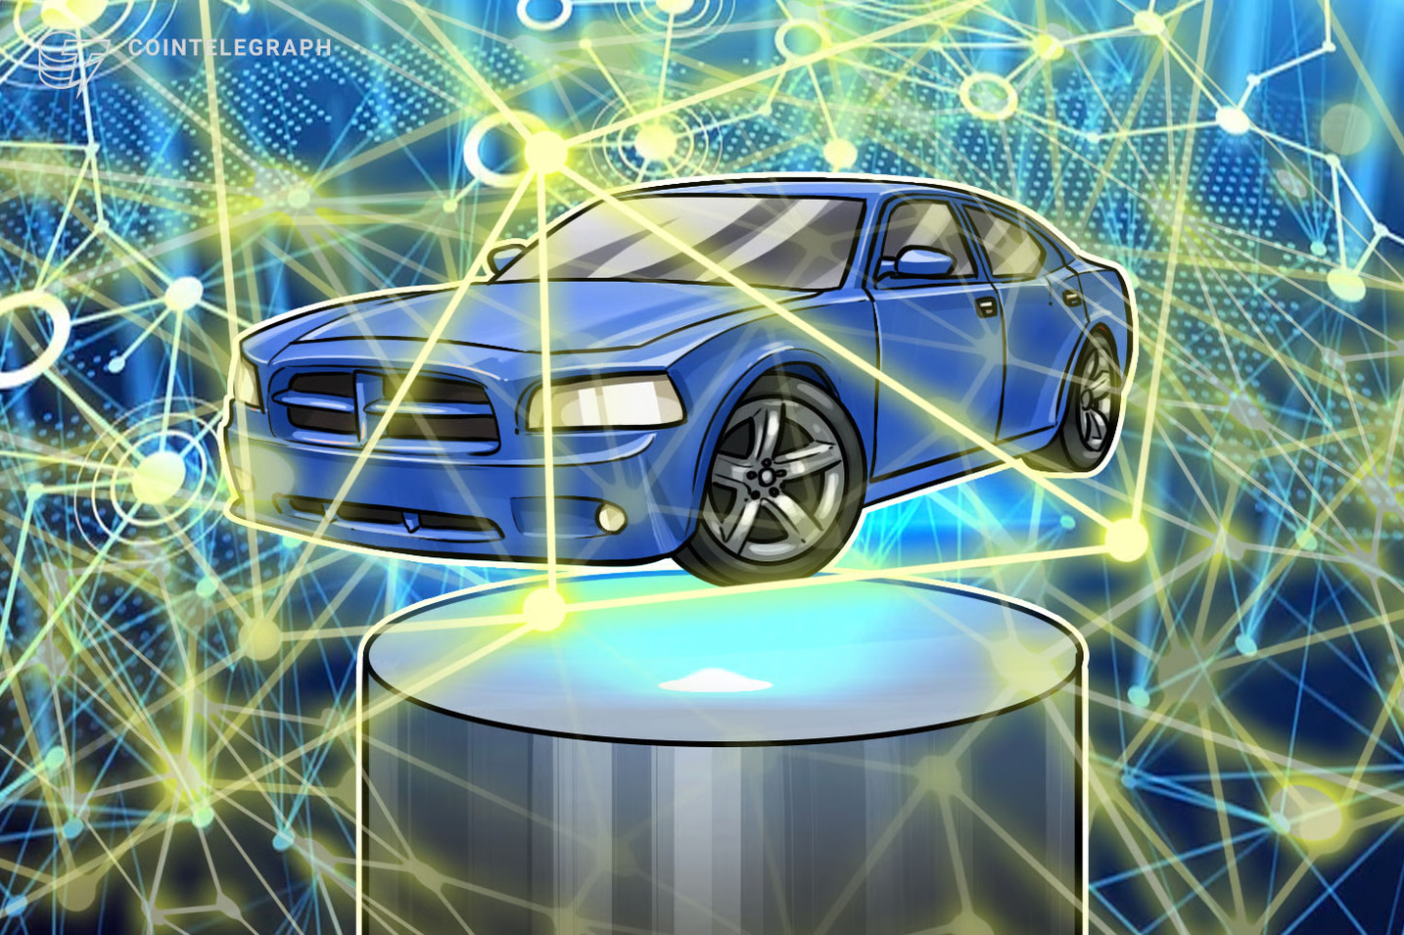
AGENDA

Slide 3
01
Introduction to Blockchain

Slide 4

1. Blockchain is a distributed ledger that uses cryptography to securely link transaction records.
2. Each new block contains a hash linking it to the previous block and transaction data.
3. Allows decentralized verification of information without a central authority using cryptography and consensus.
4. First introduced in 2008 with Bitcoin to record transactions.
5. Evolved for applications beyond cryptocurrencies including automotive systems to enhance security and cyber resilience.

Slide 5
02
Cyber-resilience in automotives

Slide 6
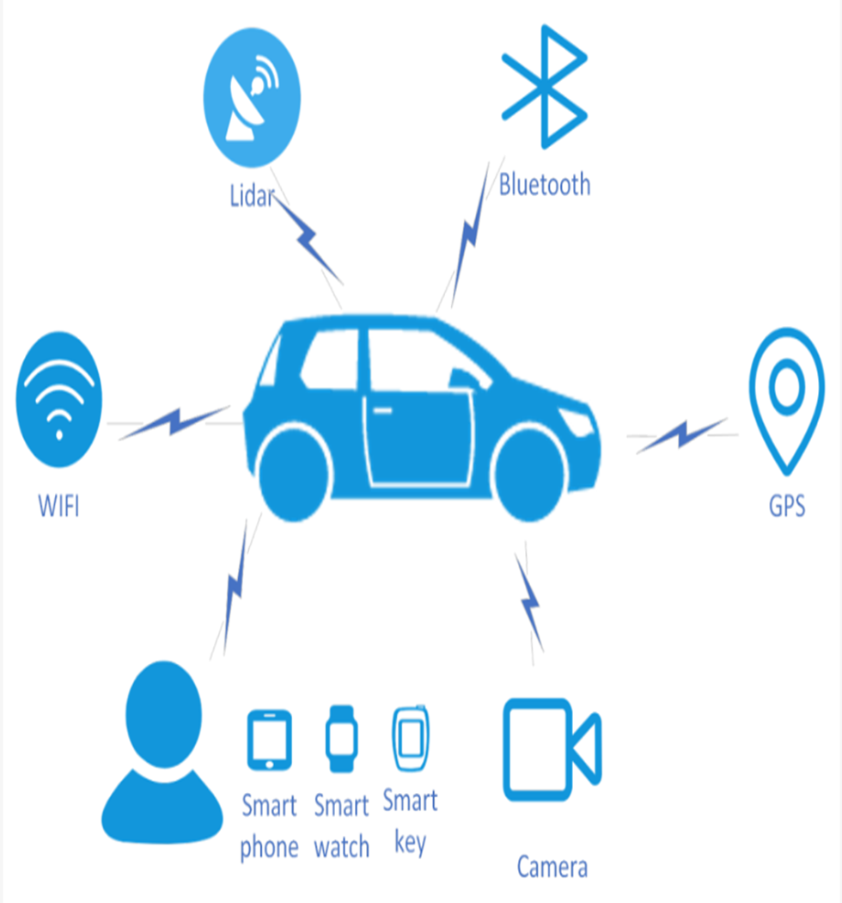
1. Vehicles are increasingly connected with internet-facing attack surfaces.
2. Threats include hacking vehicle systems, tracking/stalking drivers, and remotely disabling safety features.
3. Past breaches showed ability to hack brakes, steering, and engine remotely.
4. Lack of security updates leaves many vehicles vulnerable for years.
5. Blockchain could help address issues like weak update mechanisms and single points of failure exploited in past attacks.

Slide 7
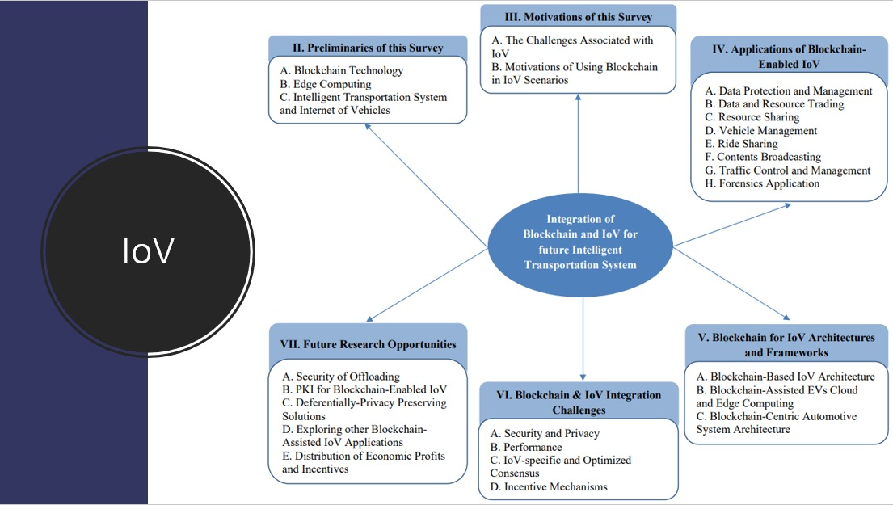

Slide 8
03
Blockchain As A Solution

Slide 9
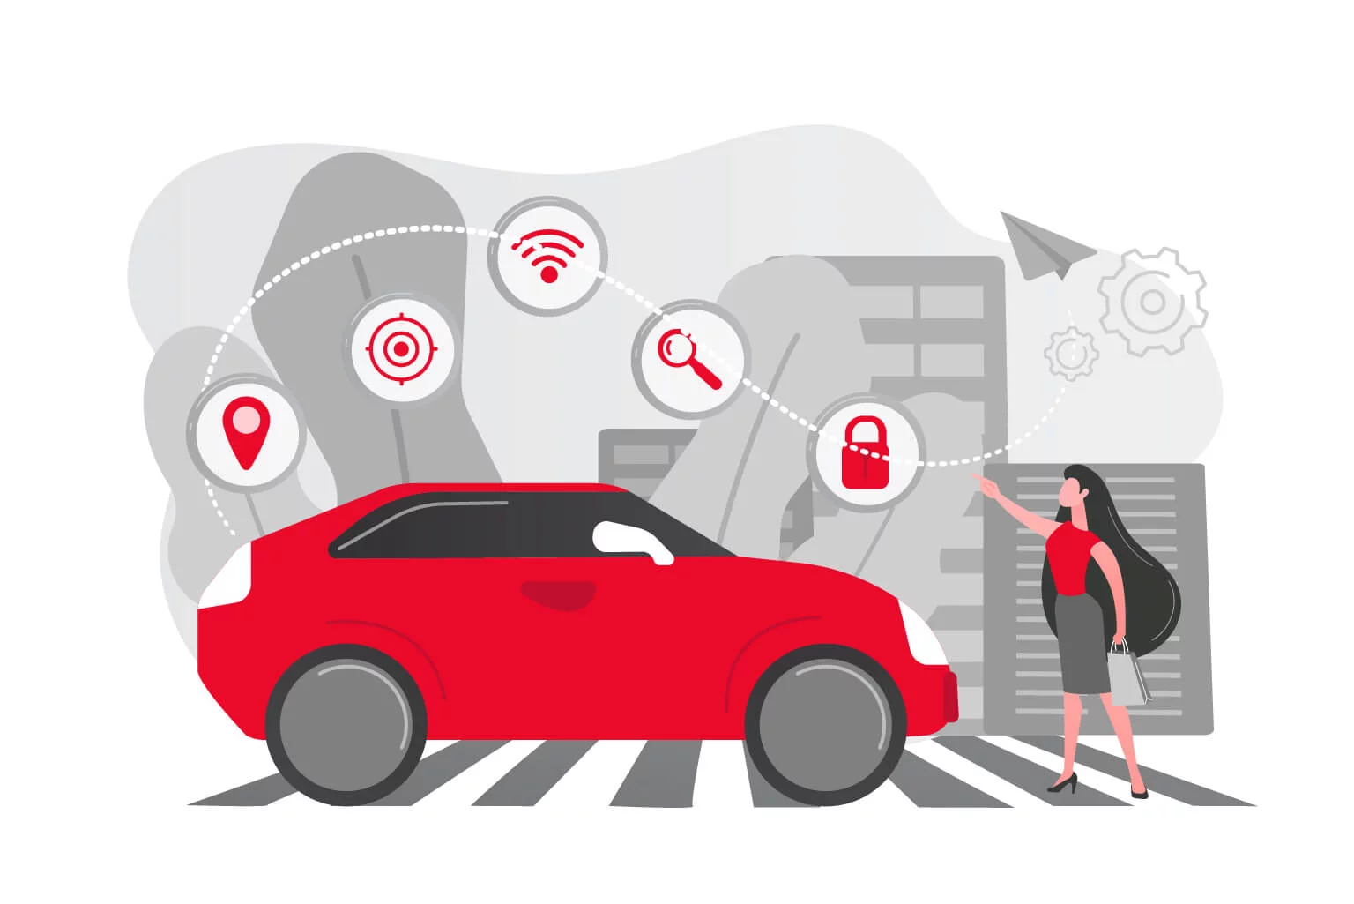
Decentralization:
Eliminates central points of failure.
Removes need for third-party intermediaries.
Tamper Resistance:
Data recorded on blockchain is nearly unalterable.
Distributed nature ensures data integrity.
Unforgeability:
Transactions are digitally signed.
Enhanced protection against impersonation.
Traceability:
Every block's data is cryptographically linked to the previous block.

Slide 10
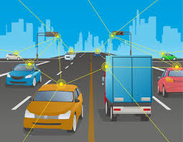
Public Audit:
Transparent transaction verification by multiple nodes.
Non-repudiation:
Ensures message senders can't deny their actions.
Simulation & Tools:
Tools like MIRACL and SUMO ensure robust simulations.
Cloud & Fog Computing:
Efficiently distributes computational tasks in vehicular networks.

Slide 11
04
Key Features of Blockchain For Automotives

Slide 12
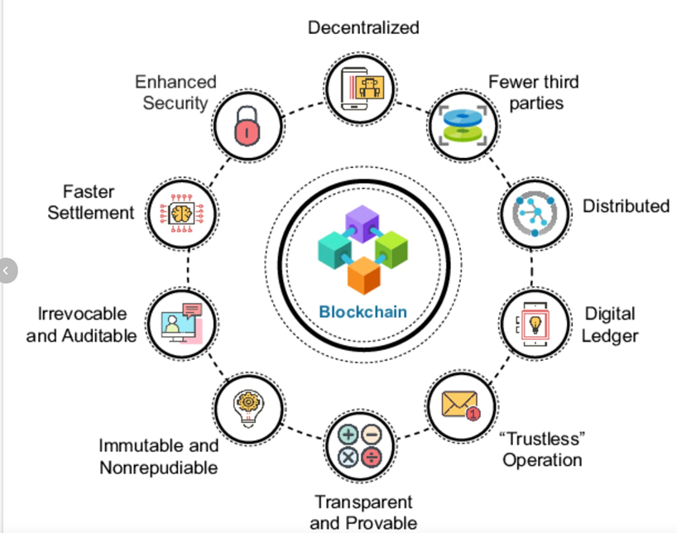

Slide 13
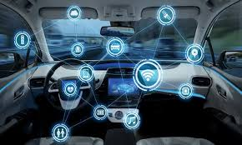
Decentralization: Blockchain operates on a decentralized network of nodes, eliminating the need for a central authority.
Immutable Ledger: Once data is recorded on a blockchain, it becomes tamper-resistant and immutable.
Enhanced Security: Blockchain employs cryptographic techniques to secure data and transactions.
Transparency: Blockchain provides a transparent and auditable ledger, allowing all authorized parties to access and verify data.
Smart Contracts: Smart contracts are self-executing agreements that automate processes and transactions when predefined conditions are met.

Slide 14
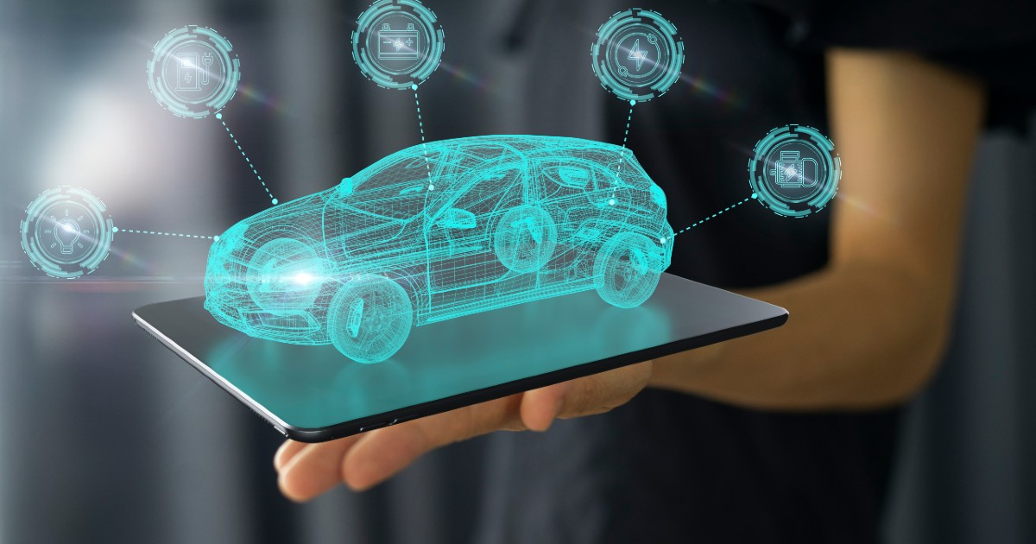
Vehicular Ad-hoc Networks (VANETs)
Mobile Ad-hoc Networks (VANETs)
VANETs are wireless communication networks designed for vehicles on the road.
Their main purpose is to enhance road safety and transportation efficiency.
VANETs use Vehicle-to-Vehicle (V2V) and Vehicle-to-Infrastructure (V2I) communication modes.
Challenges include intermittent connectivity, security, and scalability.
MANETs are decentralized wireless networks.
They have dynamic topologies and self-configure.
Nodes communicate wirelessly using specialized routing protocols.
Applications include military, disaster recovery, and IoT.

Slide 15
05
Use-cases & Applications

Slide 16
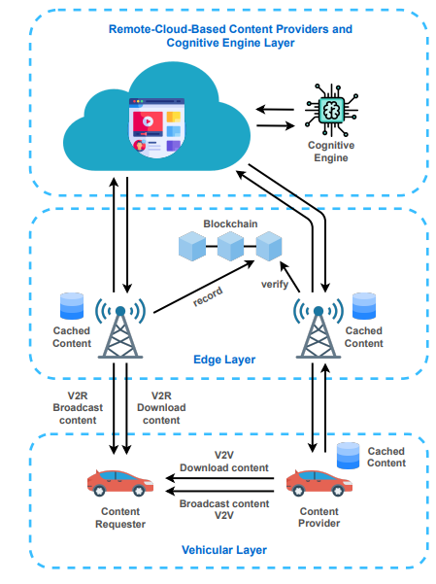
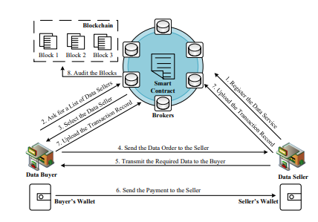
1. Secure Over-the-Air (OTA) Updates
2. V2V and V2I Communication
3. Supply Chain Transparency
4. Vehicle Identity and Access Control

Slide 17
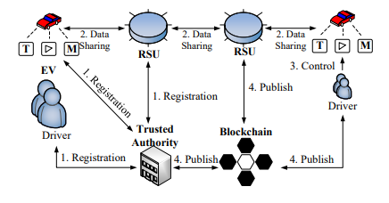
5. Automated Insurance Claims
6. Secure Data Sharing
7. Immutable Incident Records
8. Authentication and Authorization

Slide 18
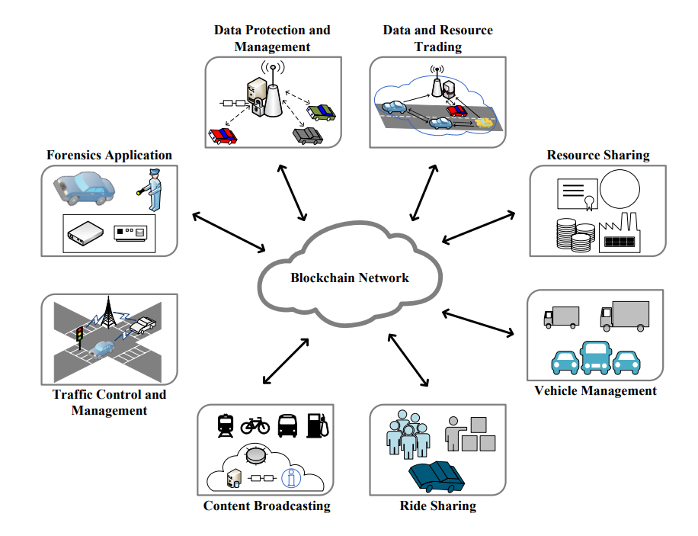

Slide 19
07
Comparative Analysis & Case Studies
Notes:
Comparative Analysis & Case Studies
1. Comparative Analysis:
Scope and Emphasis:
The first paper from EURASIP focuses primarily on applications within the Internet of Vehicles, while the second paper takes a more comprehensive look at challenges and future directions.
The paper discussing firmware updates highlights the nuances of software enhancements in autonomous vehicles, an area less emphasized in the systematic literature review.
The Federated Learning Framework study offers an intersection of machine learning and blockchain in IoV, which the paper on cyber-physical systems also touches upon but with broader implications.
Methodologies Used:
Most papers utilize a literature review methodology, but they diverge in their approach to categorizing and prioritizing findings.
The firmware update scheme paper likely involves a mix of literature review and practical experimentation or simulation to validate the proposed scheme.
Key Findings:
The majority agree on the transformative potential of blockchain in IoV.
While the firmware update paper might stress the importance of a blockchain in ensuring tamper-proof software enhancements, the Federated Learning paper emphasizes data security during machine learning processes.
Regulatory and standardization challenges are a recurring theme, especially in the comprehensive review.
2. Case Studies:
Case Study 1: Firmware Updates in Autonomous Vehicles
Background: As vehicles become more autonomous, ensuring the integrity of firmware updates becomes crucial.
Approach: The study proposed a blockchain-based scheme tailored specifically for this purpose.
Findings: Blockchain can offer a verifiable, transparent, and secure method for updating vehicle software, mitigating risks of malicious tampering.
Case Study 2: Federated Learning in IoV
Background: Federated Learning allows for decentralized machine learning, enhancing data privacy and efficiency.
Approach: The study analyzed how blockchain can secure this decentralized learning process in the realm of vehicles.
Findings: Integrating blockchain with federated learning can ensure data integrity, validate models, and establish trust among participants.
Case Study 3: Blockchain in Cyber-Physical Systems
Background: Cyber-physical systems encompass both hardware and software components. Their operation hinges on trust and data integrity.
Approach: The paper reviewed blockchain's role in ensuring the secure and smooth operation of such systems.
Findings: Blockchain can significantly enhance the security posture of these systems by ensuring data traceability, integrity, and resistance against tampering.
Case Study 4: Applications of Blockchain in IoV
Background: With the Internet of Vehicles expanding, novel applications emerge that can benefit from blockchain.
Approach: This paper from the EURASIP journal delineated several key applications.
Findings: From streamlining supply chains to ensuring secure vehicle-to-vehicle communication, blockchain stands as a pivotal technology in modern vehicular ecosystems.

Slide 20
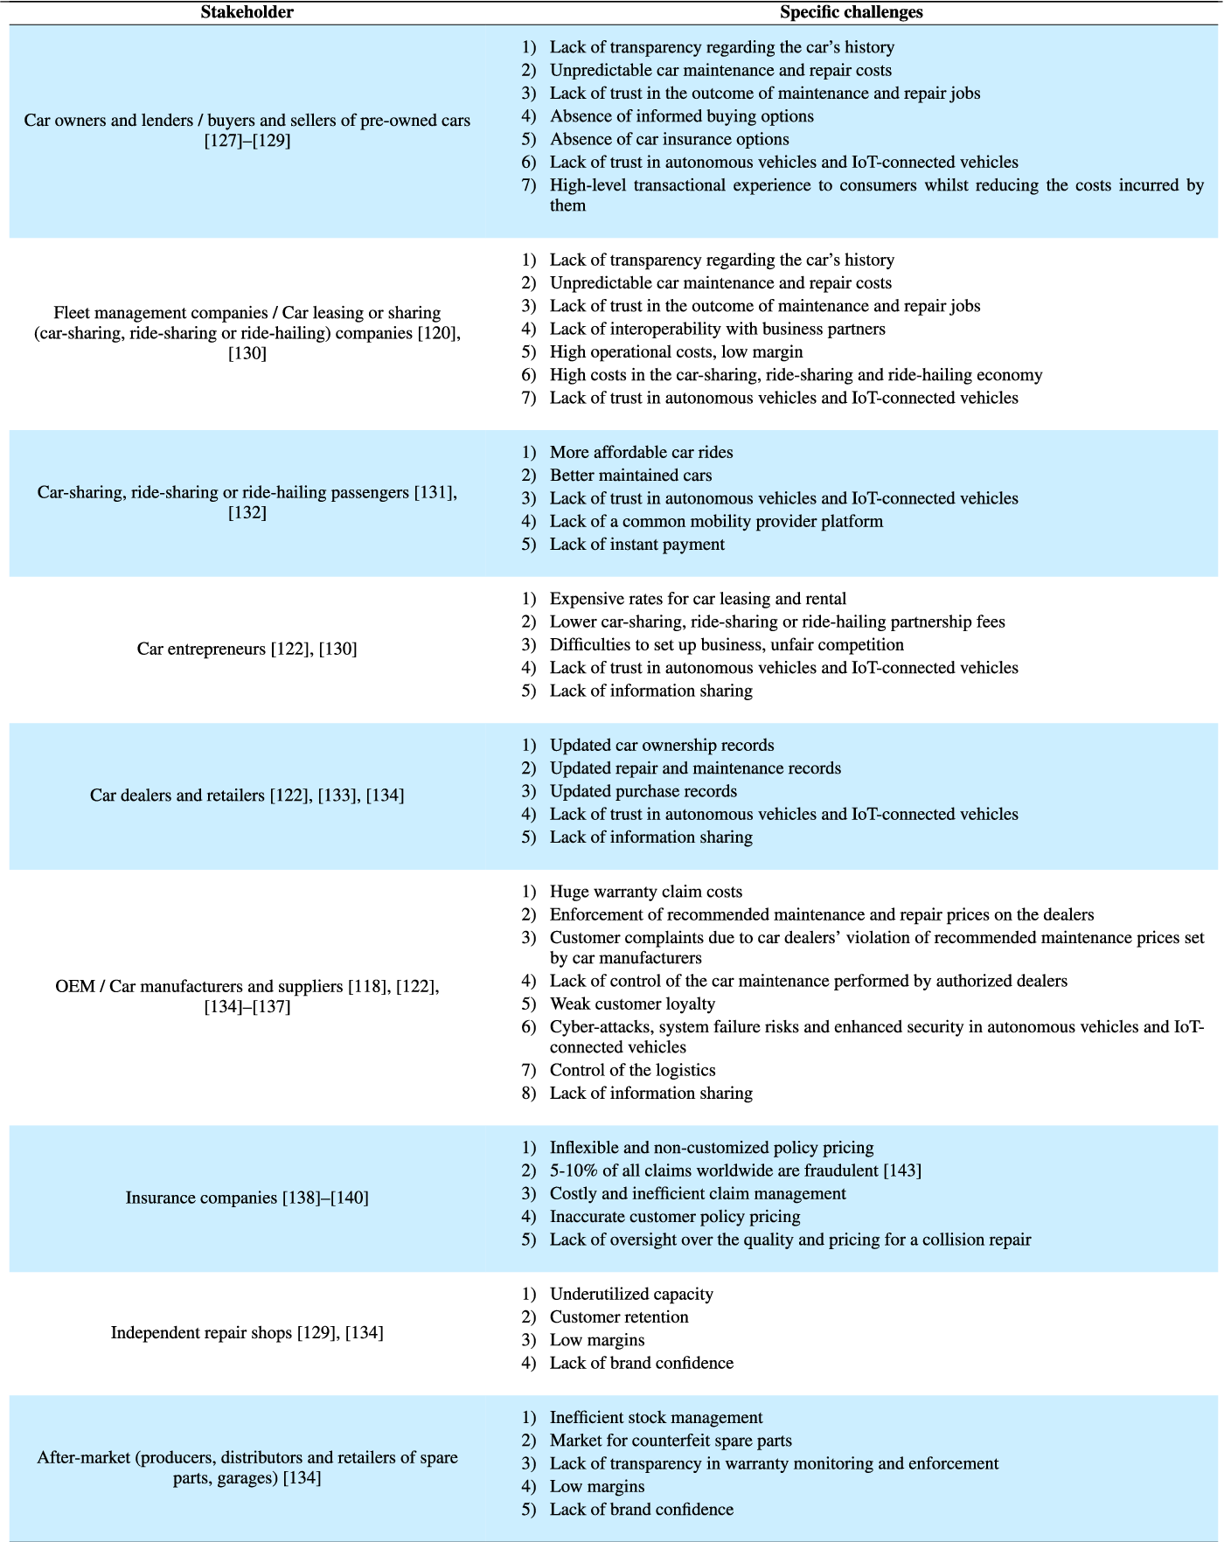
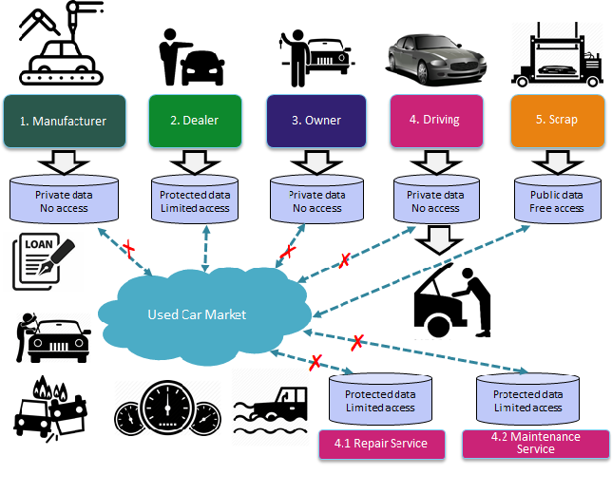
Summary comparison of previous survey articles on the A Review on Blockchain Technologies for an Advanced and Cyber-Resilient Automotive Industry.
Notes:
https://arxiv.org/pdf/2203.05192.pdf
Diving into a comparative analysis and some riveting case studies on blockchain in the realm of the Internet of Vehicles (IoV).
The Internet of Vehicles (IoV) is a system where vehicles connect and communicate with each other and their surroundings using technology. It enhances safety, optimizes traffic, and provides advanced features for users.
In our comparative study:
Two main papers surfaced; one focusing on IoV's applications and the other on its challenges and future.
There's a fascinating piece on firmware in autonomous vehicles, underscoring the intricate aspects of software updates.
Another work intertwines machine learning and blockchain in IoV, hinting at broad applications in cyber-physical systems.
Most authors favor a literature review. However, the methodology varies, particularly in categorizing findings.
A common consensus? Blockchain's transformative role in IoV, whether for tamper-proof software updates or ensuring data security in machine learning.
Onto our case studies:
Firmware in Autonomous Vehicles: As cars get smarter, firmware's integrity is paramount. Here, blockchain emerges as a savior, ensuring updates are transparent, secure, and untampered.
Federated Learning in IoV: Decentralizing machine learning can bolster data privacy. And guess what? Blockchain can further secure this decentralized process.
Blockchain in Cyber-Physical Systems: Trust is essential when hardware meets software. Blockchain's role? Elevate security, ensuring data traceability and tamper resistance.
Blockchain Applications in IoV: The IoV universe is vast. A study from EURASIP highlighted how blockchain is revolutionizing areas from supply chains to vehicle communications.
delve into the key challenges faced by various stakeholders in the automotive sector:
Car Owners & Buyers of Pre-owned Cars:
Transparency issues around car history
Unpredictable maintenance costs
Informed buying options are scarce.
Fleet Management & Sharing Companies:
Fleet management is the coordination and supervision of a company's vehicles to improve efficiency and reduce costs.
Concerns about transparency of car histories
Worries about the outcome of maintenance and repair tasks
High costs in the sharing economy.
Ride-sharing Passengers:
A desire for more affordable rides
Trust issues with autonomous and IoT-connected vehicles
The absence of a common platform for mobility services.
Car Entrepreneurs:
High rates for car leasing
Challenges in forging strong partnerships
Concerns about trust in new automotive technologies.
Car Dealers & Retailers:
A need for updated ownership and repair records
Lingering trust issues with autonomous and IoT-connected vehicles.
OEMs/Car Manufacturers & Suppliers:
OEMs, or "Original Equipment Manufacturers," are companies that produce parts and equipment that may be marketed by another company.
Warranty claim costs
Pressures from recommended maintenance prices
Cybersecurity risks in newer car technologies.
Insurance Companies:
Rigid policy pricing
Concerns about fraudulent claims
Need for oversight in collision repair quality and pricing.
Independent Repair Shops:
Issues in retaining customers
Challenges with low profit margins
Struggles with building brand trust.
After-market Stakeholders:
Fraudulent spare parts
Monitoring and enforcement challenges
Concerns over thin profit margins.
In essence, while the automotive world advances, stakeholders grapple with multifaceted challenges. Identifying and addressing these will shape the industry's future.

Slide 21
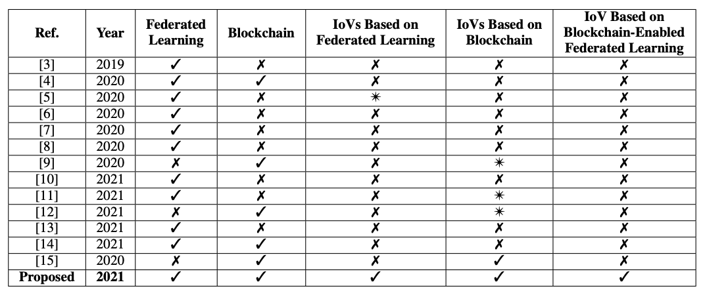
Summary comparison of previous survey articles on the Internet of Vehicles (IoVs). ’✓’ indicates that the topic is covered, ’✗’ indicates that the topic is not covered, and ’✴’ indicates that the topic is partially covered.
Notes:
https://arxiv.org/pdf/2203.05192.pdf
"In a quick comparison of past survey articles on the Internet of Vehicles (IoVs):
Most articles from 2019 to 2021 covered Federated Learning.
Blockchain was a focus in a select few, especially in 2020 and 2021.
A limited number touched upon IoVs based on Federated Learning, with one in 2020 showing partial coverage.
Even fewer discussed IoVs based on Blockchain.
And notably, only a single article in 2021 addressed IoV that integrates both Blockchain and Federated Learning.
This overview provides insights into the research trajectory in the realm of IoVs."

Slide 22
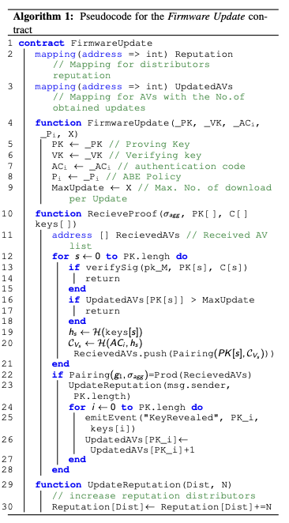
Algorithm 1: Pseudocode for the Firmware Update contract
Notes:
We have a firmware update contract designed for efficient and secure updates. It features:
Mappings:
A reputation mapping for distributors.
A tracking system for AVs based on the number of updates received.
Main Functionality:
Our FirmwareUpdate function establishes keys for proof, verification, and an authentication code. It also sets a maximum download policy.
The ReceiveProof function handles the proof of firmware updates, verifying given keys and tracking received updates.
Finally, we have the UpdateReputation function, which increments the reputation of distributors based on the reliability and authenticity of the updates they provide.
In essence, this contract ensures secure firmware updates by checking the authenticity of updates and monitoring distributor reputations."
--I'd like to walk you through a system we've designed for ensuring the secure and efficient updating of firmware:
Contract Structure:
Our system is encapsulated in a contract named FirmwareUpdate.
Within this, we have two primary data mappings: a. Reputation: This is essentially a ledger that keeps track of the reliability of various distributors, ensuring we prioritize updates from trustworthy sources. b. UpdatedAVs: A record of the number of updates each AV (or Autonomous Vehicle) has received.
Key Functions:
FirmwareUpdate: When called, this function sets essential cryptographic elements such as the Proving Key, Verifying Key, and an Authentication Code. Moreover, there's a policy established to determine the maximum number of times a particular update can be downloaded.
ReceiveProof: This is crucial for security. Before an AV receives an update, the proof of that update is verified. If the proof doesn't match, or if the update exceeds the max limit, the process terminates.
UpdateReputation: Post verification, if the update is genuine, the distributor's reputation gets a positive bump. This ensures that reliable distributors are recognized and incentivized.
In summary, our contract promotes the seamless and secure updating of firmware by combining cryptographic verification, tracking mechanisms, and a reputation system to ensure only genuine updates are installed."

Slide 23
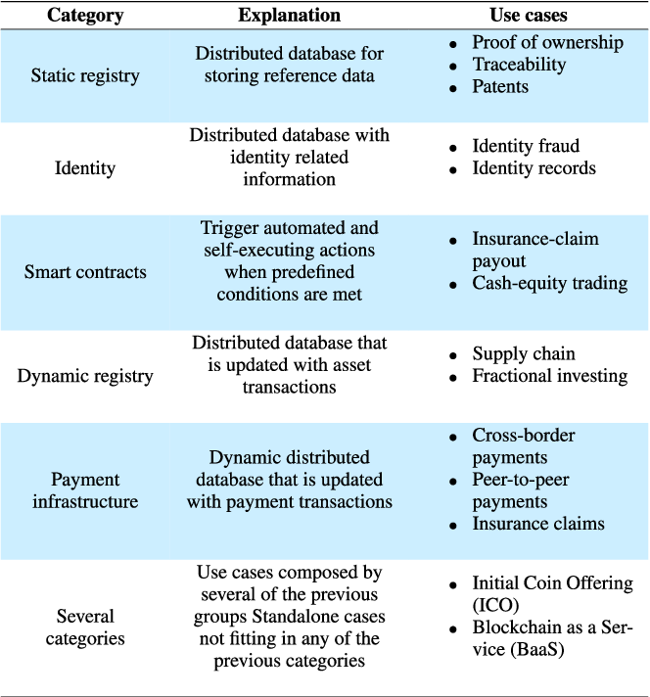
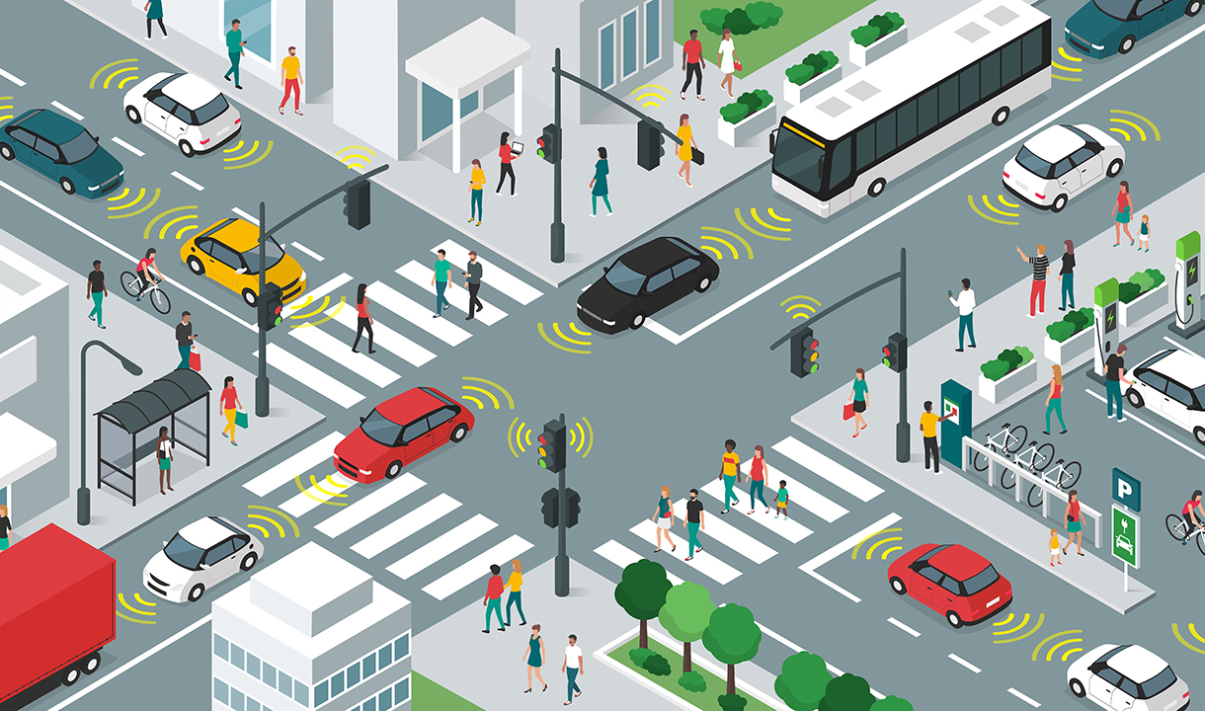
Case Studies:
Firmware Updates in Autonomous Vehicles
Federated Learning in IoV
Blockchain in Cyber-Physical Systems
Applications of Blockchain in IoV
Notes:
to briefly discuss the diverse applications of blockchain technology.
Blockchain Categories:
Static registry: Think of this as a distributed database that stores reference data. The primary use cases here include proving ownership, traceability, and patents.
Identity: This deals with a distributed database containing identity-related information, crucial for mitigating identity fraud and securely maintaining identity records.
Smart contracts: These are automated, self-executing actions triggered when specific conditions are met. Perfect for applications like insurance-claim payouts and cash-equity trading.
Dynamic registry: This is an evolving database that records asset transactions, predominantly used in supply chains and fractional investing.
Payment infrastructure: A dynamic distributed system focusing on transaction updates. Ideal for cross-border payments, peer-to-peer transfers, and processing insurance claims.
Several categories: Some use cases, like Initial Coin Offerings (ICOs) or Blockchain-as-a-Service (BaaS), are unique and don't neatly fit into one category.
Case Studies:
The capabilities of blockchain extend into the real world, from ensuring secure firmware updates in autonomous vehicles to its role in federated learning within the Internet of Vehicles (IoV). Furthermore, it's vital in cyber-physical systems and has vast applications within IoV.
In essence, blockchain's versatility is revolutionizing various sectors, offering enhanced security, transparency, and automation

Slide 24
08
Future Prospects & Evolutions

Slide 25
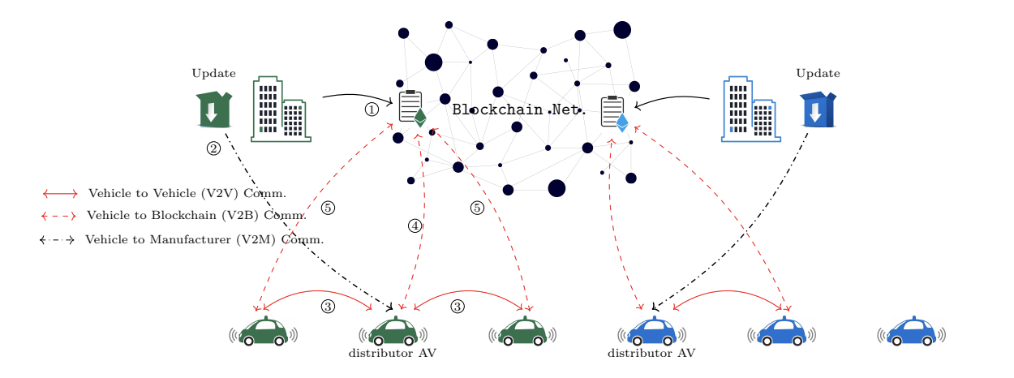
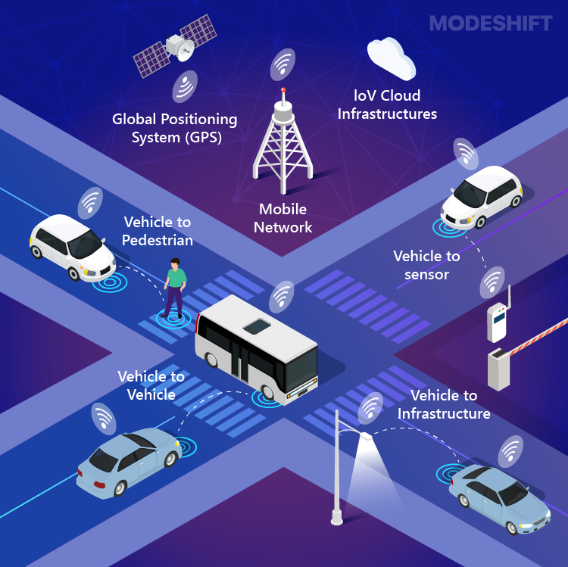
IoT & AI Integration
Augmented Reality (AR) & Virtual Reality (VR) Integration
Supply Chain Transparency
Peer-to-Peer Models
Enhanced Security Frameworks
Notes:
Convergence: Cars may soon transact with banks and power grids directly.
Consensus Protocols: Energy-efficient mechanisms like Proof-of-Stake could dominate automotive blockchains.
Security: Quantum computing demands next-level blockchain security.
IoT & AI: Cars making data-driven decisions and logging them on blockchains.
Identity: Decentralized solutions could offer user-based insurance models.
Regulations: Tailored global rules for blockchain in autos are on the horizon.
Transparency: Know your car's materials' origins and eco-footprint.
Peer-to-Peer: Direct car sharing or data exchanges, more efficient and cost-effective.
Smart Contracts: Evolving to handle dynamic, complex agreements.
AR & VR: Blockchain-powered virtual automotive experiences.
Green Blockchain: Prioritizing sustainability in blockchain operations.
The fusion of blockchain and autos is redefining our mobility future.

Slide 26
09
Conclusion & Call to Action

Slide 27
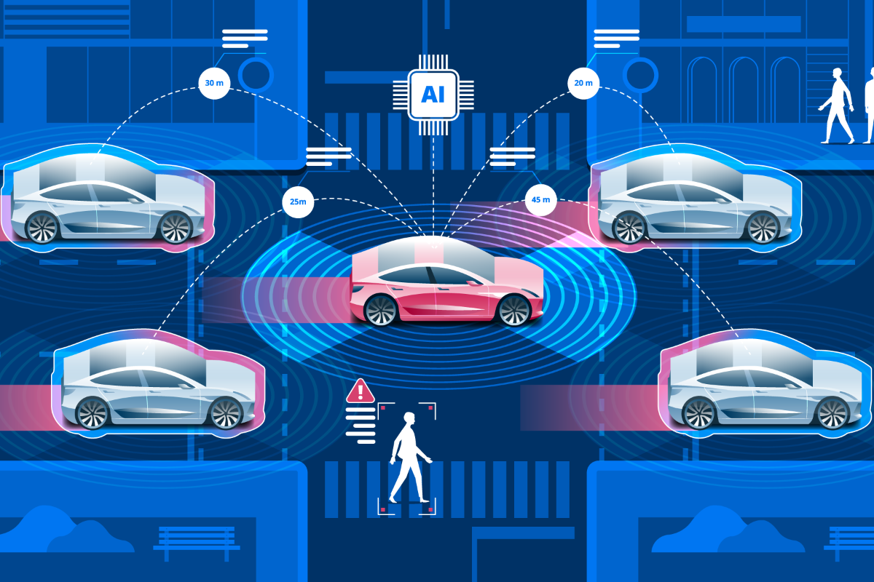
As vehicles evolve into more connected, intelligent entities, the synergy of blockchain and IoV will be instrumental in shaping a future of transportation that is not only smart and efficient but also secure and trustworthy.
Notes:
Vehicles are becoming smarter and more connected. Imagine combining the security of blockchain with the intelligence of the Internet of Vehicles, or IoV. This union will lead us to a transport future that's efficient, secure, and reliable. Yes, there are hurdles, but with teamwork and research, we're optimistic. We're just beginning this exciting journey of merging blockchain with IoV, but the progress so far and the possibilities ahead are truly inspiring. Thank you.

Slide 28
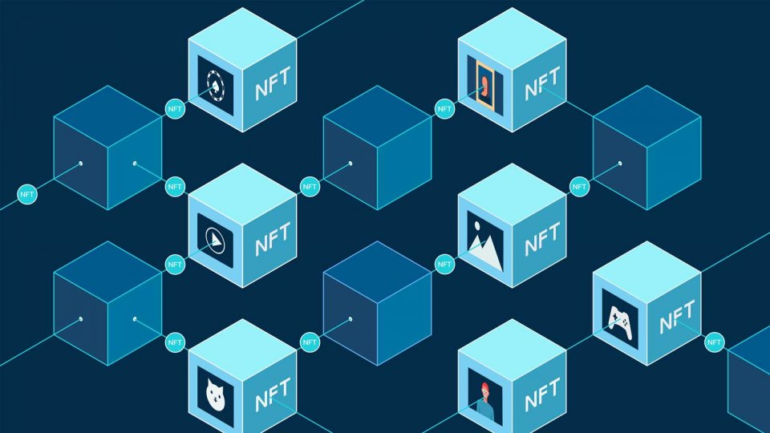
THANKS

